Slide 1

Project Proposal Phase 1
Checkers
By CS 301 Group 1
Notes:
Zayd will say ”Our group 1 have decided that our project proposal is going to be checkers“

Slide 2




Group 1 Members
Zayd Ali
Noor Ashfaq
Hasibullah Ayoubi
Project Manager
Tech Lead
QA
Notes:
Each member will introduce themselves saying their name, and their role for the project

Slide 3

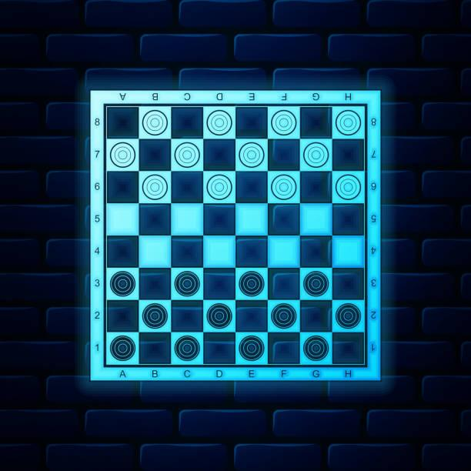
Checkers game
User/Player
AI
Checker Piece
Board
Helper
Extra Features
Project Synopsis
Notes:
Zayd will give a brief summary about the project ”Our project is to design a checkers game that takes user input to select and move their desired pieces on the board in order to win the game using the command prompt.”
Then proceed to mention the major elements of the program.

Slide 4

THE USER/PLAYER:
Two options: face off against another player or against an AI
Prompted for piece choice, and position to move it to
Notes:
Noor will speak here.
“The user will get the option to choose if they want to face off against another player or against an AI.”
“They will be prompted to choose the checker piece that they want to move and where to move it on the board.”

Slide 5
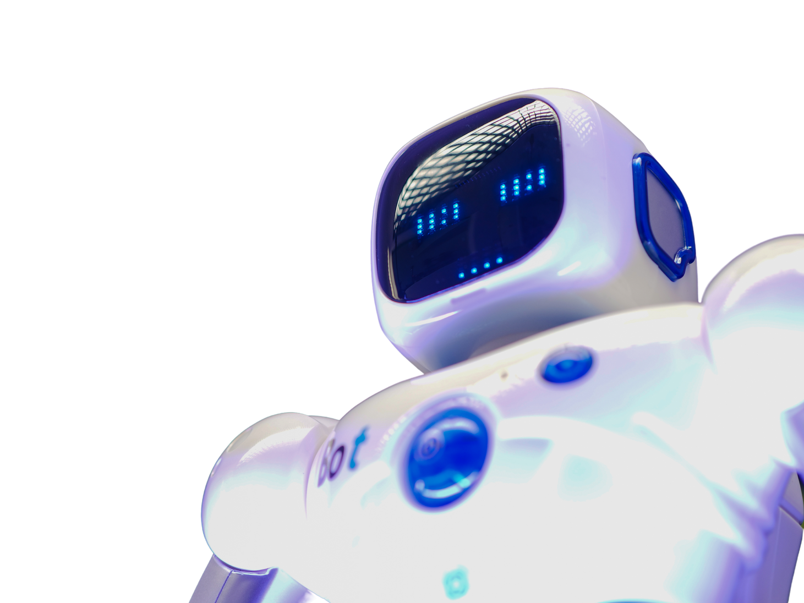
The AI:
Random number generator
The AI difficulty implementation
Notes:
Hasib will speak here.
“The AI will be using a random number generator in order to make a random move that is available to it. The AI could be improved so that it will always choose the option to jump over its opponent's piece if available”

Slide 6

The Checker Piece:
An object identified by a number
Movement on board
Jumping over enemy pieces
Promotion
Removal
Notes:
Zayd will speak here.
Every checker piece will be its own object of type Checker that is identified by a number. It will have the following functions: moves forward, checks if it can move, jumps over an opponent’s piece, checks if it can jump, checks if it can jump multiple times in one turn, it gets promoted, allows it to move backwards, checks if the piece has been jumped over, removes the checker piece from the board if it has been jumped over.

Slide 7

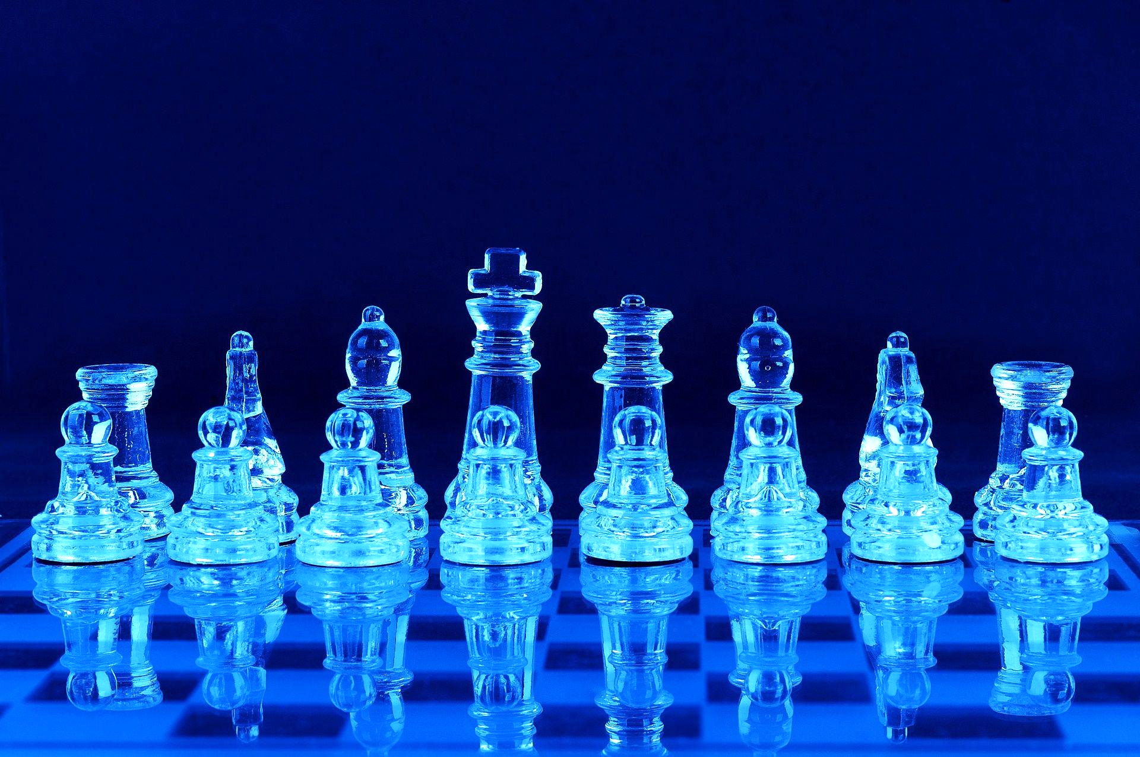
The Board:
Series of symbols that are printed out to command console
Positions of all pieces will be checked and updated on the board
Status of pieces will also be checked and updated on the board
Notes:
Noor will speak here.
“The board is an object of type Board. It will be a series of symbols that is printed out to the command console after every user input. After every user input the board will be updated.”
“The positions of the pieces on the board will be checked, updating which space is occupied by whom or if the space is empty.”
“The top and bottom rows will also be checked if there are any pieces that need to be promoted.”

Slide 8

THE HELPER:
Basically, it is like an assistant.
Shows the user the available spots.
Notes:
Hasib will speak here
It will tell the user when they choose a piece, the available spots it can move to or jump over. It’s like an assistant.

Slide 9

Extra Features:
Score Tracker
Different gameplay and visuals
Turn timer
Notes:
Zayd will speak here.
“A tracker that will track how many pieces have been removed from each player and will declare victory once all of an opponent's pieces have been consumed”
“We also are considering to change the visual and gameplay of the game using a website or an app so it becomes point and click instead ”
“We might also implement a player turn timer where if the player hasn’t made a move and the timer runs out then a random move will be done instead”

Slide 10
Layered Development Schedule
LAYER 1 Functional Minimum | Player object class - void move() Checker piece object class - void remove() Board object class - void board()
LAYER 2 Low Target | void userInput() bool promote() void jump()
LAYER 3 Desirable Target | bool moveCheck() bool jumpCheck() bool jumpedOver()
LAYER 4 High Target | void multipleJump() bool multipleJumpCheck() int PossibleMove() void promoteMove()
LAYER 5 Extras | Create an AI object class Extra features
Notes:
Zayd will start speaking: “Here is our layered development plan, we decided to divide our target goals by the different functions needed. For example, in the functional minimum layer, we will be creating the different object classes for the board, checker piece, and player. Then we will create the basic functions necessary such as move() which moves the checker piece, remove() which removes the checker piece, and board() which prints out the checkerboard constantly. Once we have a solid foundation, the higher layers consist of different functions that add up on the previous functions in order to get a working game”
Noor talks about layer 2 and 3 explaining what each function does: “For our low target layer we have 3 functions userInput(), promote(), and jump(). userInput will prompt the user to input a checker piece and a position to move it to. The promote() function will give a piece the ability to move backwards and jump() will give a piece the ability to jump over an opponent piece. And for our desirable target, there are also 3 functions which are moveCheck(), jumpCheck(), and jumpedOver(). moveCheck() will check if a piece can move or not. jumpCheck() will check if there are any opponent pieces that can be jumped over, and jumpedOver() will be called and assigned to a piece when it has been jumped over. These functions will build the basic core of our application and the higher layers will solidify this core.”
Hasib talks about layer 4 and 5 explaining what each function does.

Slide 11
Team Member Roles
Project Manager | Tech Lead | QA
Layer 1: Create a player object class Layer 2: userInput() Layer 3: jumpCheck() Layer 4: multipleJump() - multipleJumpCheck() | Layer 1: Create a board object class, remove(), board() Layer 2: Jump() Layer 3: moveCheck() Layer 4: promoteMove() | Layer 1: Create checker piece object class Layer 2: promote() Layer 3: jumpedOver() Layer 4: PossibleMove()
Zayd
Noor
Hasib
Notes:
Each member will mention which functions they are working on for the project for each of the layer

Slide 12
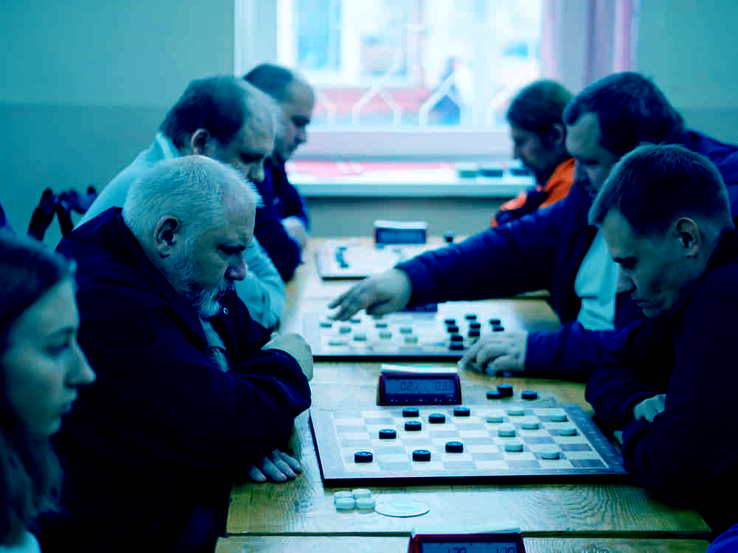
ASSESSMENT:
User friendly interface
Learn basic rules and practice
Criteria is based on the standards of a real checkers game
Notes:
Noor will start off the assessment of the project, “The main usage of the application will be by those who are interested in checkers. But we plan to make the user interface very beginner-friendly so anyone can use it. Users can learn the basic rules of checkers and put their newly learned knowledge into practice against another player or an AI opponent.
Hasib takes over, “As for the criteria used to judge whether or not this design is a success, we plan to play our application alongside a real checkers game program and see if that satisfies all the requirements of a proper checkers game from start to finish and use that as our basis for our standards. For example, the promotion of pieces or the act of eliminating an opponent’s piece. These criteria should be met and able to be performed successfully for this design to be considered a success.

Slide 13
THANK YOU!
Notes:
Zayd concludes
“And that's our project plan for phase 1, thank you”

